Slide 1
Classification of musical genres Final project for Applied Machine Learning 2020
Eliot, Mads and Sofus

Slide 2
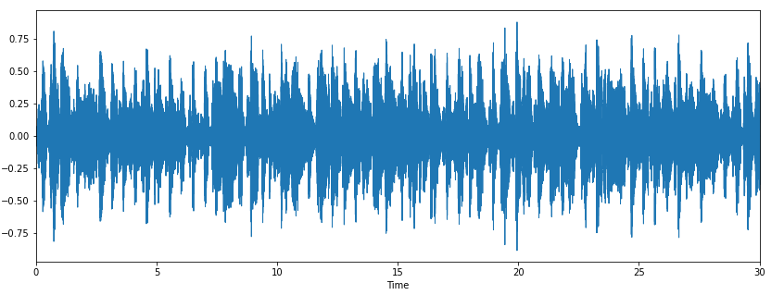
Finding features
We use the GTZAN dataset [1]
1000 songs in 10 genres: pop, jazz, blues, classical, hiphop, metal, rock, reggae, disco, country
Decided it was fun to find our own features and use a bunch of different approaches
Use Timbre and Librosa python packages
train_features =
Librosa: zerocrossing, spectralrolloff, chromagramstd,
chromagrammean, chroma_cens
Timbre: hardness, depth, brightness, roughness, warmth,
sharpness, boominess
Additional: fourier_std, fourier_mean

Slide 3
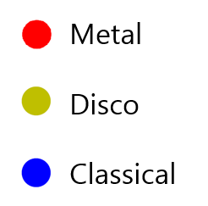
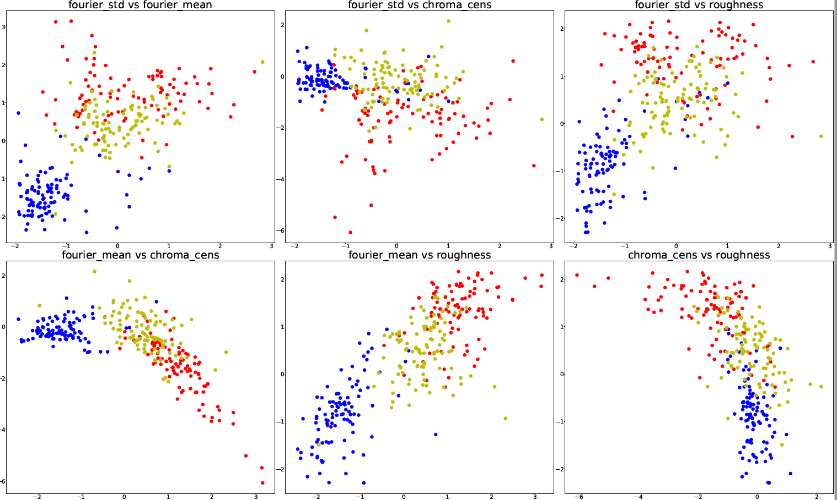
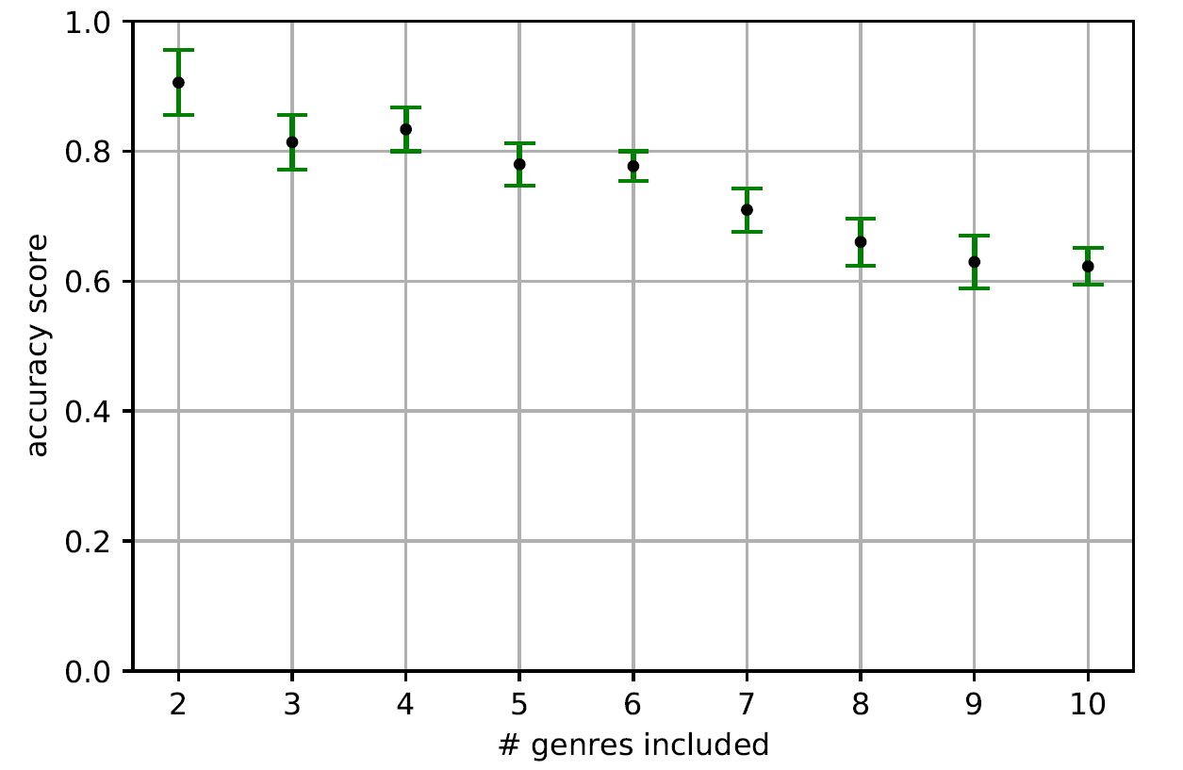
The initial approach: Gradient boosted tree and Nearest Neighbor
For three genres, kNeighbour gives an
accuracy score of 0.99 +/- 0.04 with
50 fold cross validation
This drops to 0.55+/- 0.11 for 10 genres
For three genres, LightGBM classifier gives an accuracy score of 0.80+/- 0.03, but holds up better for more genres.

Slide 4
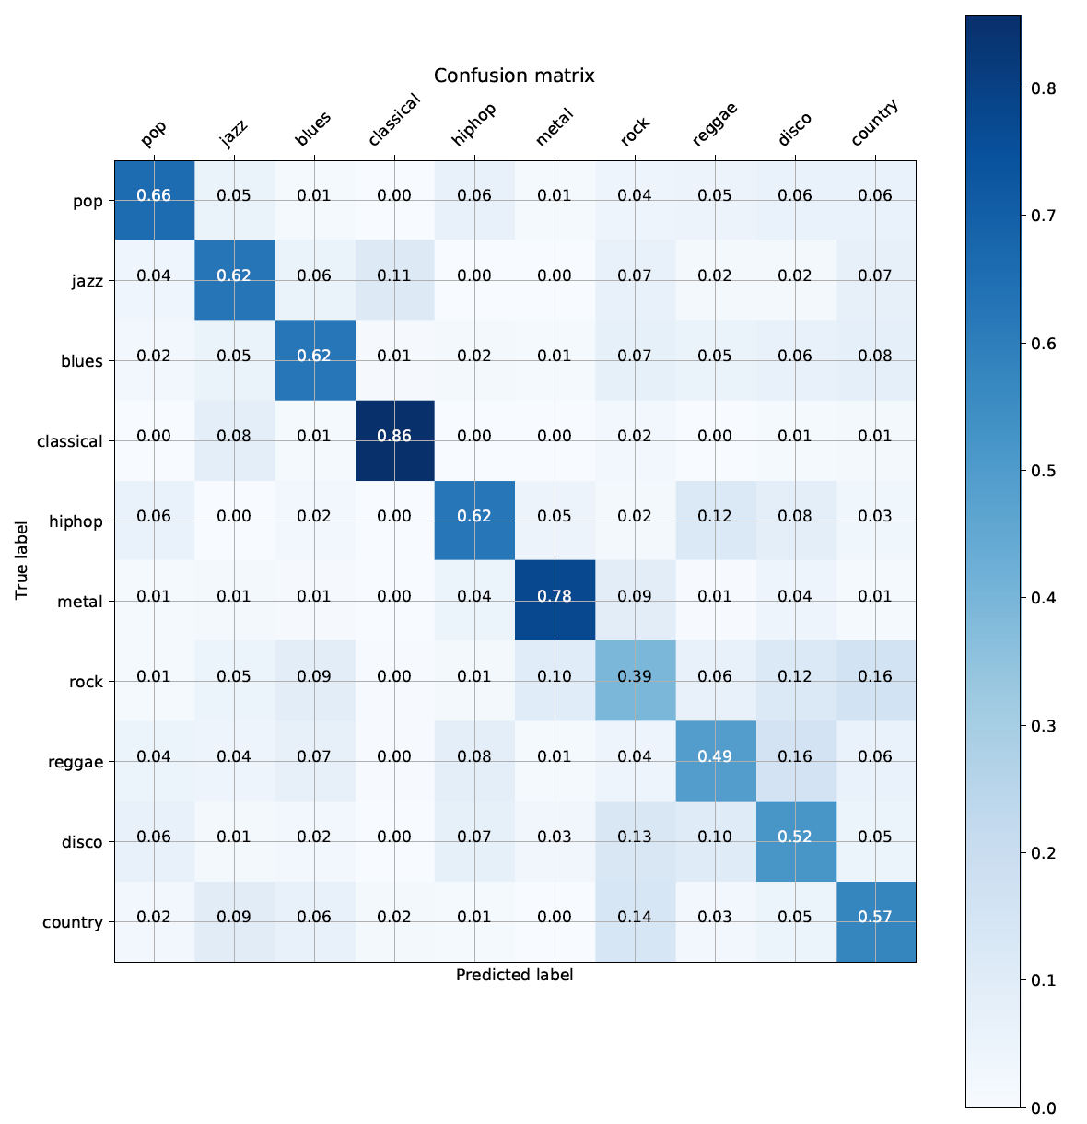
Finding errors in the prediction – what genres are hardest to predict?
Classical and metal are easiest to predict
Rock is hardest, which makes sense intuitively – vaguely defined!
Can we introduce variables that improves the guesses on the lowest scoring classes?

Slide 5
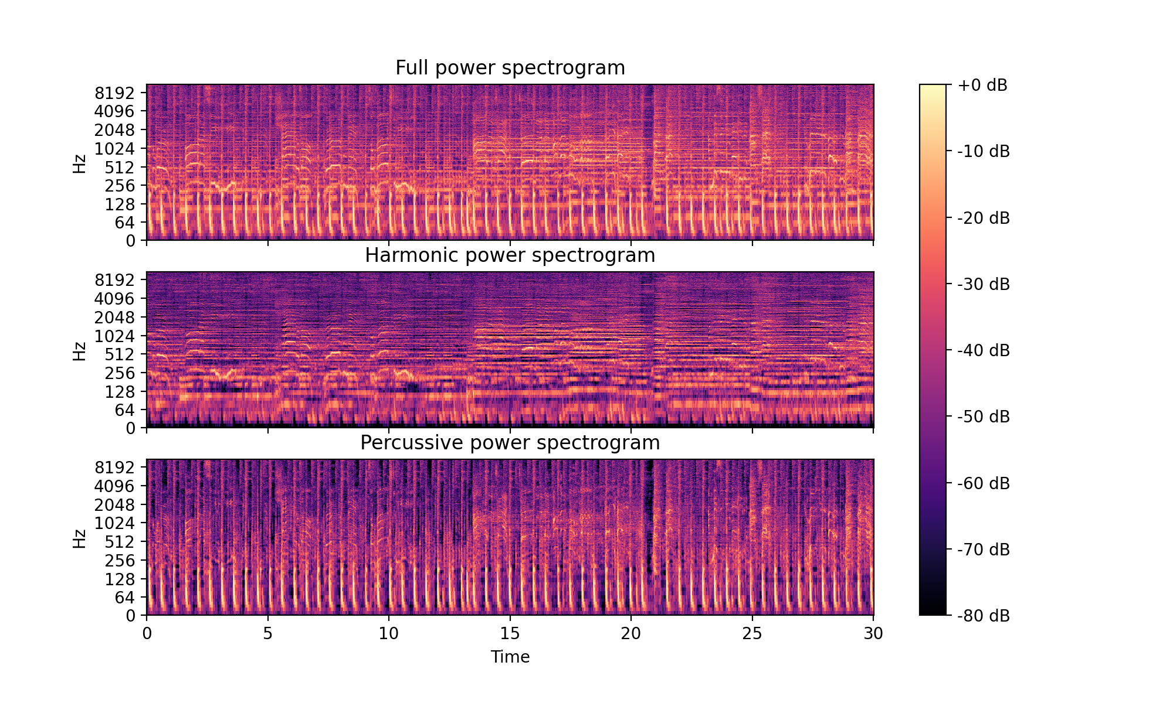
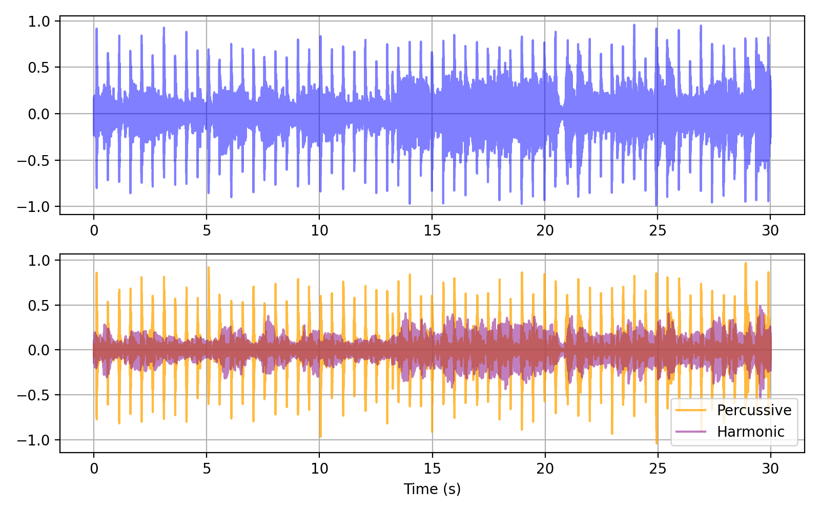
Harmonic Percussive Source Separation
Median filtering of spectrogram
Analyse melodic and rythmic features separately
For details on HPSS, see: Derry FitzGerald Proc. of the 13th Int. Conference on Digital Audio Effects (DAFx-10) (2010)

Slide 6
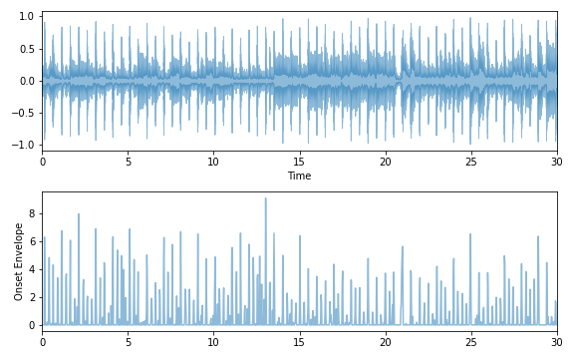
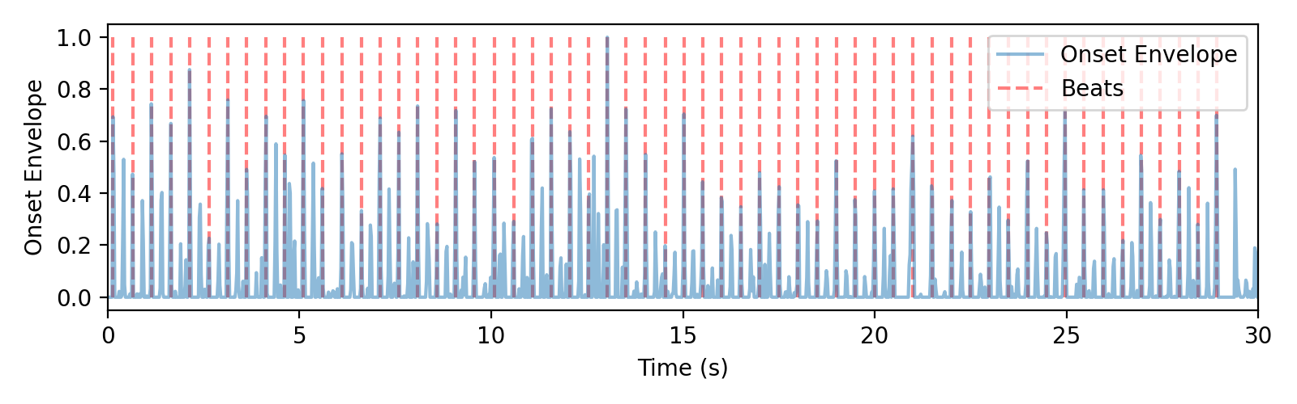
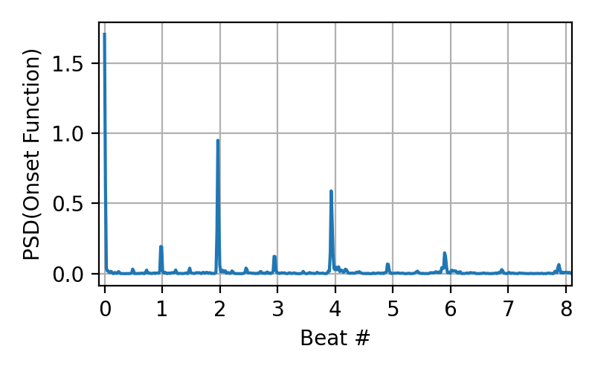
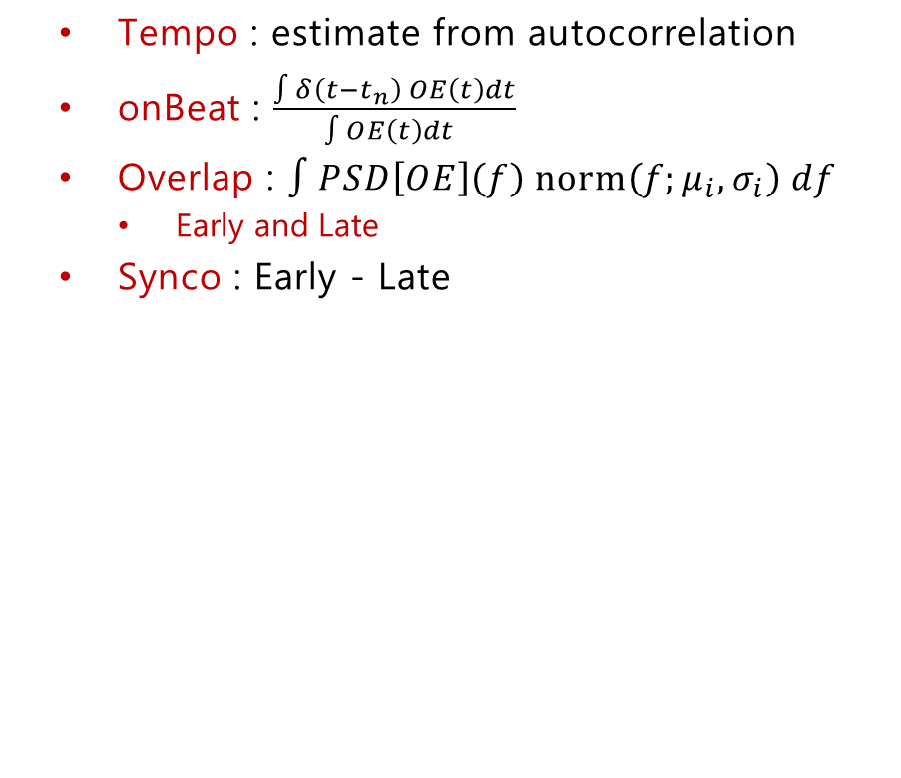
Rythmic features
Tempo : estimate from autocorrelation
onBeat : $\frac{∫δ\left(t−t_{n}\right) OE\left(t\right)dt}{∫OE\left(t\right)dt }$
Overlap : $∫PSD\left[OE\right]\left(f\right) norm\left(f;μ_{i},σ_{i}\right) df$
Early and Late
Synco : Early - Late

Slide 7
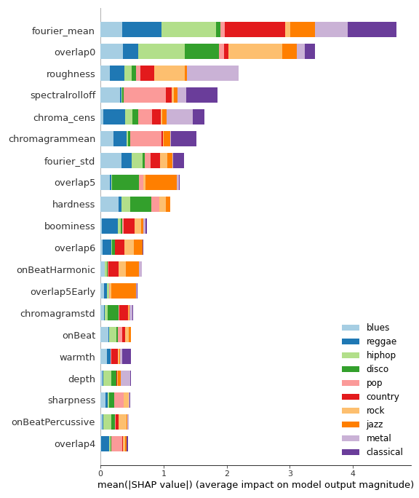
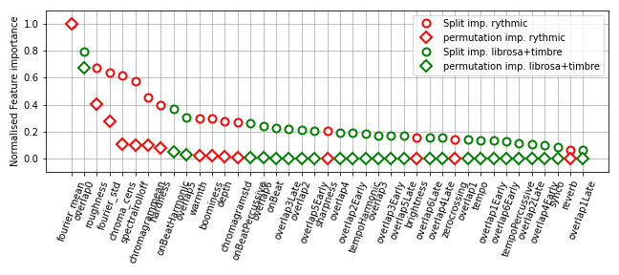
Feature Importance
Permutation (10 repeats) and split importance
SHAP values
… Homemade features are competitive!

Slide 8
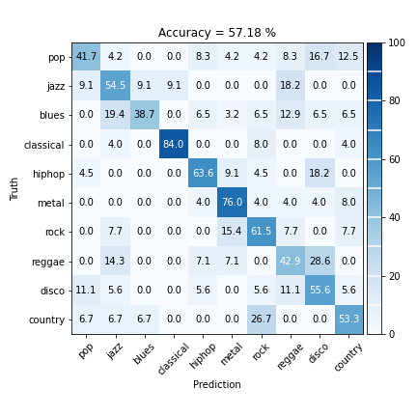
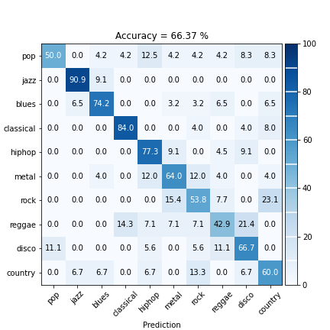
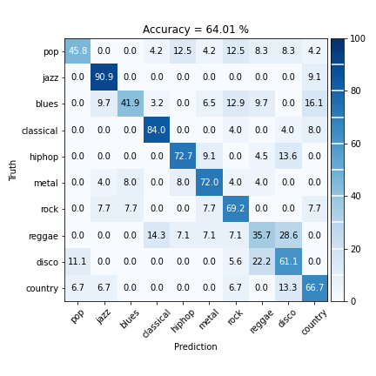
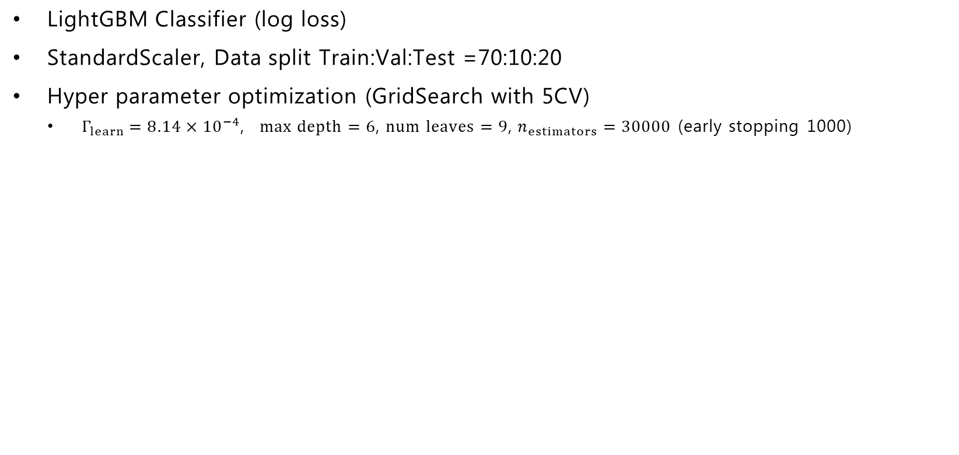
Improvement?
LightGBM Classifier (log loss)
StandardScaler, Data split Train:Val:Test =70:10:20
Hyper parameter optimization (GridSearch with 5CV)
$Γ_{learn}=8.14×{10}^{−4}$, $max depth=6$, $num leaves=9$, $n_{estimators}=30000$ (early stopping 1000)
Modest improvement!
Librosa & timbre: All 41 variables: Top 10 variables:
Truth

Slide 9
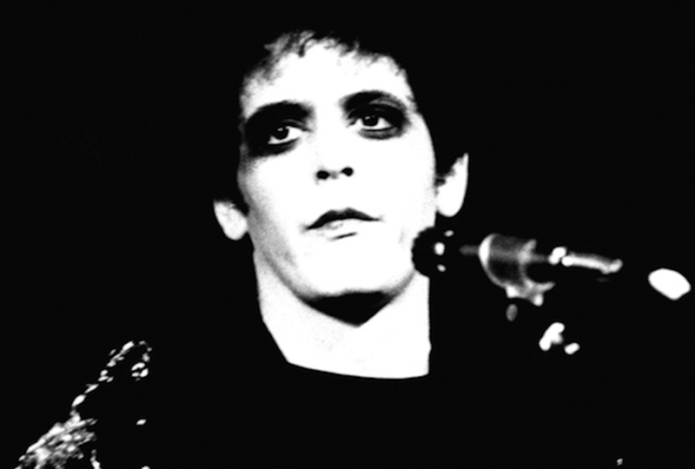
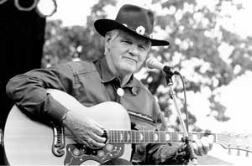
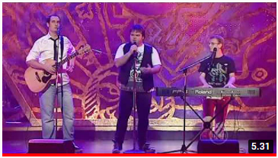
Rythmic features improves model somewhat
Surprising for me that ”Early” & ”Late” variables aren’t more important
Many variables, little data...
Get more data
Dimensionality reduction
Recursive feature elimination
More advanced hyper parameter optimization
Extract chords and their progressions from Harmonic component
”If it has more than three chords, it is jazz”
– Lou Reed
”Country music is three chords and the truth”
– Harlan Howard
”so you can take those 4 chords and pump out every pop song?!”

Slide 10
Different approach: Neural network with MFCC’s
If you play the same note on a guitar and a piano with the same amplitude, what makes them sound different is timbre
Volume
Frequency
Notes:
Is the distinguishing characteristic that differentiates on e sound from another, despite the fact that they may be playing the same pitch with the same volume

Slide 11
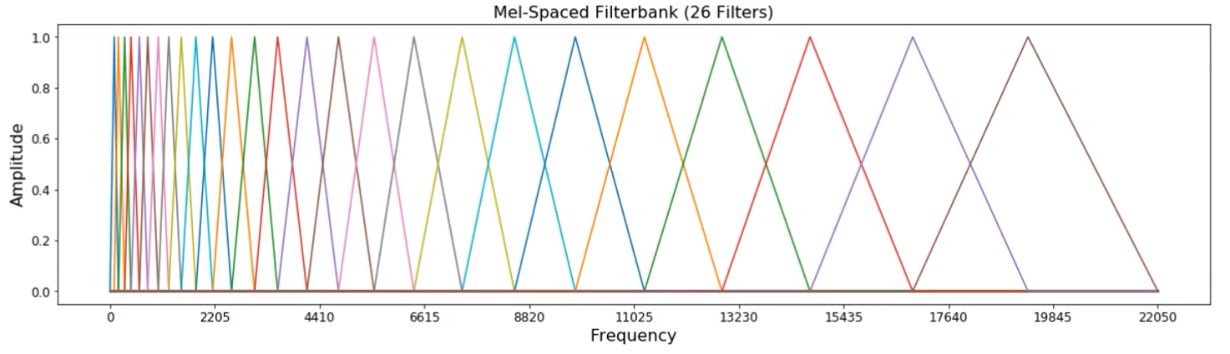
Mel-frequency cepstral coefficients (MFCCs)
Waveform
DFT
Log-Amplitude Spectrum
Mel-Scaling
Discrete Cosine
Transform
MFCC
Notes:
Taking fast fourier transform in segments called the “hop length” or “window length” and stacking them adjacently over time
Apply logarithm, perceptually relevant, we perceive loudness logarithmically.
Take the log spectrum, pas from linear based frequency scaling to a log. and apply filter banks, with this triangular filter. Instead of applying inverse fourier, apply discrete cosine transform.
Discrete cosine transform: simplified version of fourier transform, get real-valued coefficient. Correlate energies in different mel-bands, which is good for machine learning because we want lists which are as correlated as possible.
Reduce # of dimensions to represent spectrum
Going to separate the spectral envelope from the spectral details (high freq)
The advantage of MFCC is that they try to model the way we perceive frequency. The way we process audio
Originally for speech recognition. Emotion detection.
Now used for genre classification and also instrument classification
As humans, it’s very easy to tell the difference between low freq values. Between 10 and 100 Hz is very obvious. However 15,000 and 15,100 Hz, Humans can’t tell the difference.
The idea behind the mel scale is to transform linear frequencies, we want to transform those linear frequencies to a logarithmic scale. We don’t really care the difference in large frequencies, but we care a lot about differences in low frequencies. So we rebin the frequency content to make it more accurately represent what a human might find important in an audio signal.
We create a filter bank, and the standard is with 26 filters. The spacing is called the Mel Scale. 26 bins to bin your energy into. These triangle filters build features based on the power spectral density.
This creates very relevant for audio classification.
Discrete cosine transform – can think of as a low pass filter for different energies. The lower frequencies matter a lot for timbre, so we just keep 13 coefficients.

Slide 12
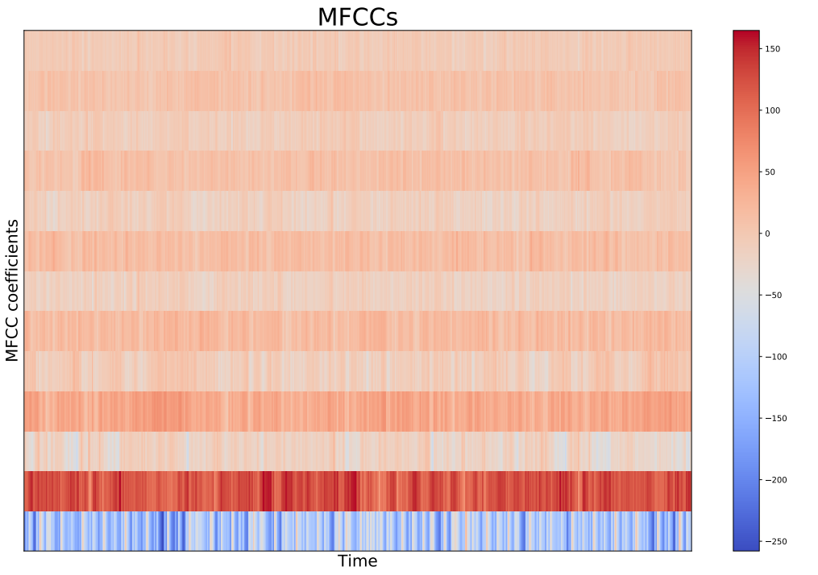
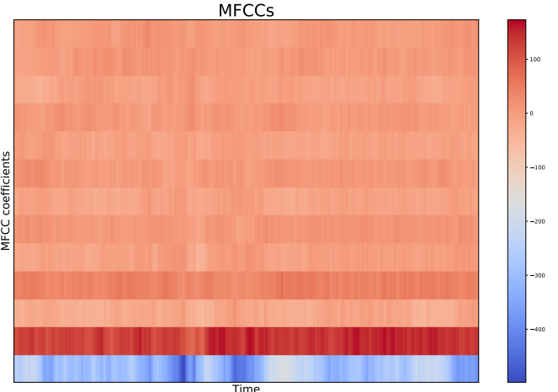
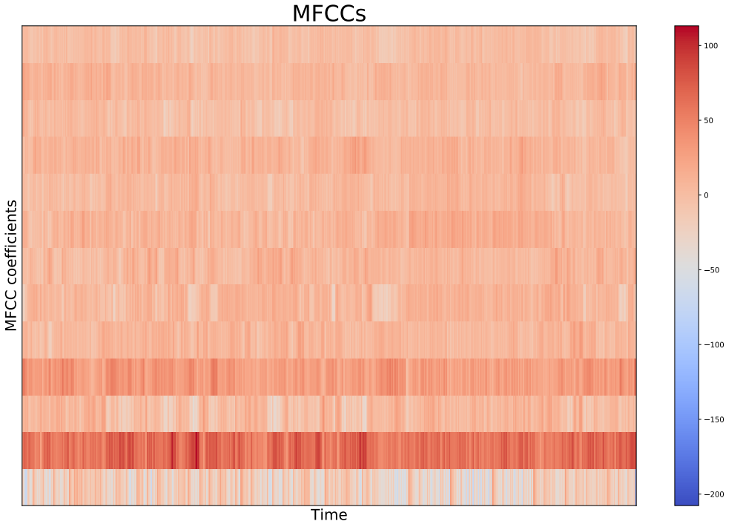
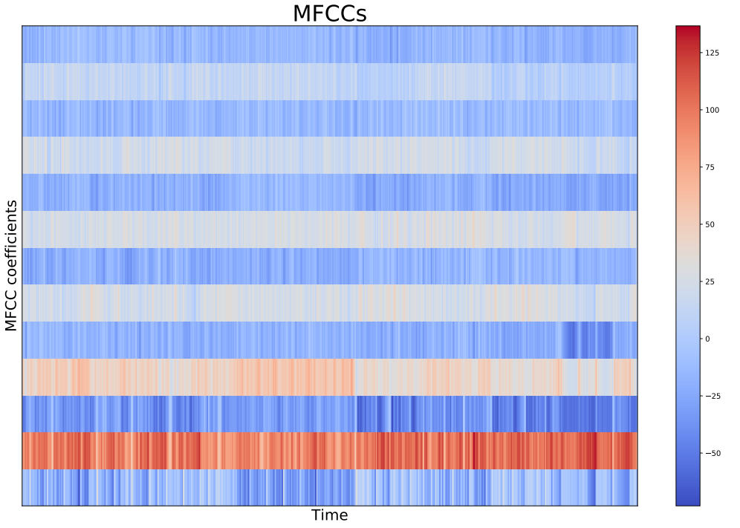
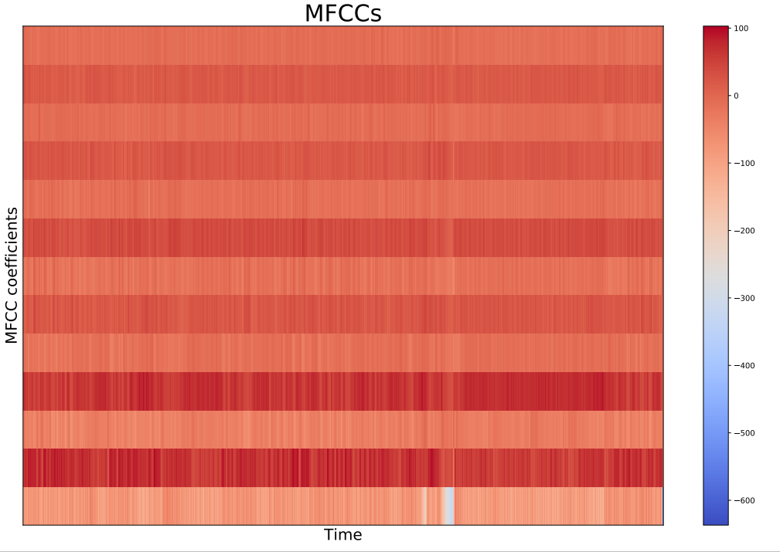
Example MFCCs
Blues
Classical
Country
Rock
Metal
Notes:
On x axis we have time. On y axis we have different coefficient (13), at each value we have the mfcc index at a certain time.
First coefficients provide information for spectral envelope

Slide 13
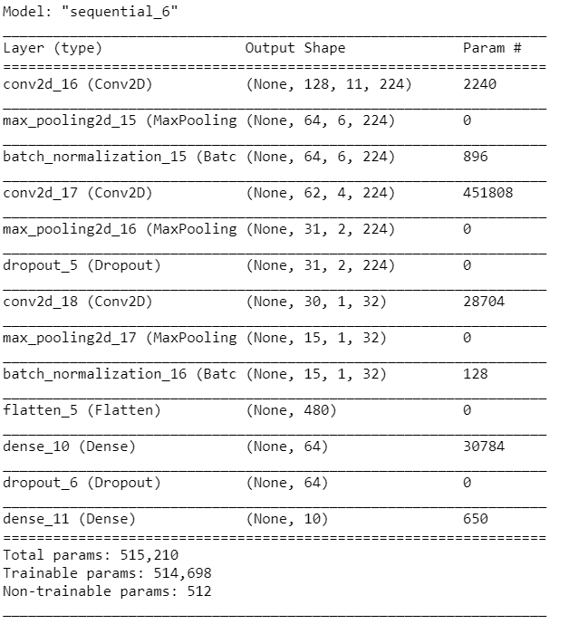
Conventional Neural Network
Used Keras.Sequential to build CNN
3 x Convolution layer, max pooling, batch normalization
1 Dense layer with 64 neurons
Dropout layer
Dense layer with 10 neurons
50 epochs used
Takes ~1 hour to train
Optimized using Keras.Tuner “RandomSearch”
number of convolution/dense layers
number of filters in each layer
Dropout layers
# of neurons in Dense layer
Notes:
Max Pooling
Strides
Batch size
Batch normalization. Even small changes in early layers, get amplified through the network and cause a shift in distribution of following layers. Batch normalization -

Slide 14
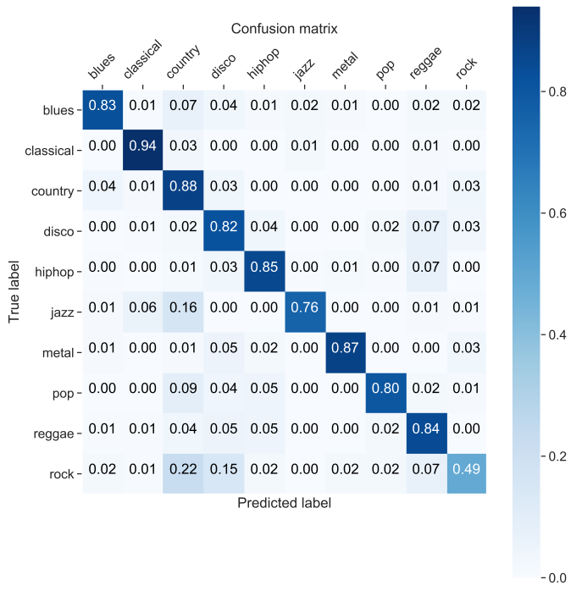
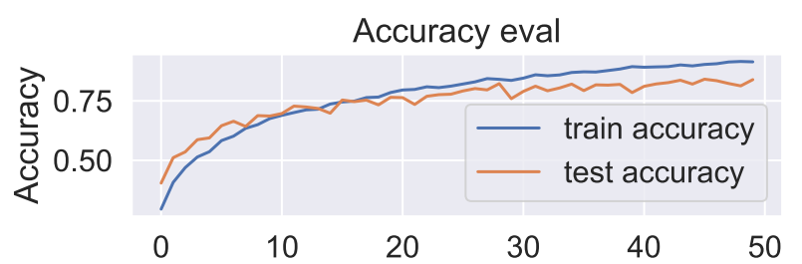
Results
Epochs
Data split Train:Val:Test =60:20:20
Scores 83.7% on Test data on all 10 genres
Classical and metal are easiest to predict
Rock is hardest, mostly mis-labeled as country
Notes:
Perhaps if we combined some genres, it would be higher

Slide 15
Outlook
CNN is a good model for classifying music
I don’t think it will get much better, since humans can’t always classify genres perfectly
Would like to keep optimizing more hyperparameters in the CNN
Try to extract instruments in all the tracks
Notes:
Very sufficient for Classifying music

Slide 16
Appendix

Slide 17
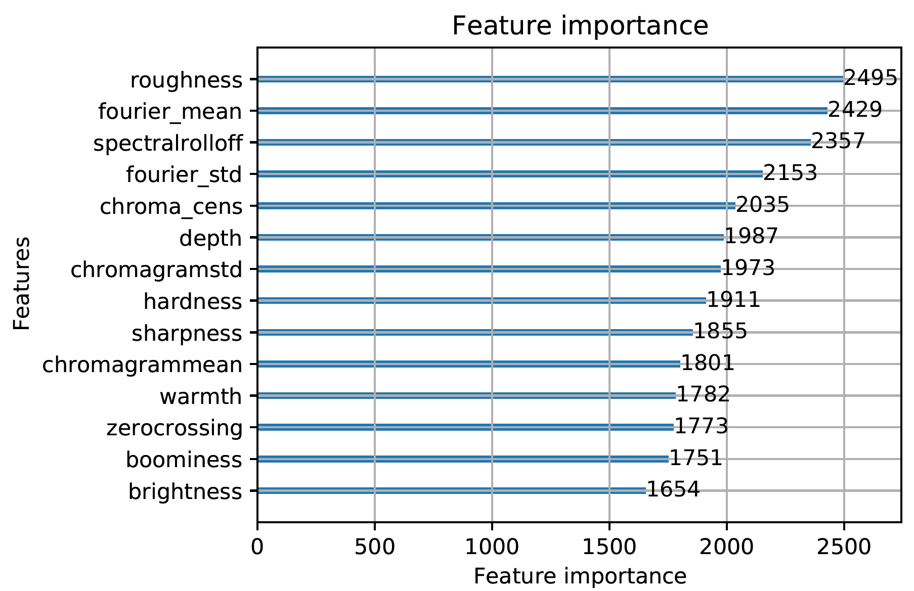
Feature importance of initial approach
The variables all contribute to the classification. Surprisingly, one of the most important variables is the mean of the fourier transform, done by hand.

Slide 18
Optimizing tree-based algorithm
We use LightGBM for the initial attempts at efficient classification.
The optimal parameters we found to be:
n_epochs = 500
n_leafs = 10
max_depth = 10
This yields a logloss of 0.3 for the multi-classification algorithm, using LightGBM cross validation.

Slide 19
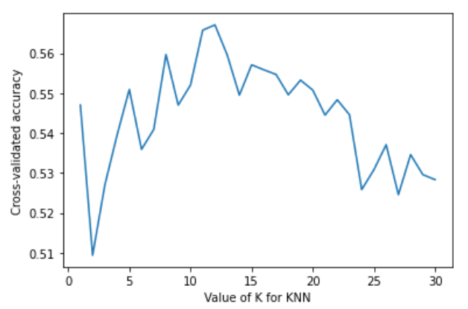
kNearestneighbor
The kNearestneighbor is very straight-forward and easy to use. This is the approach that many have used on the data set.
We use n_neighbors = 12, based on simple optimization.

Slide 20
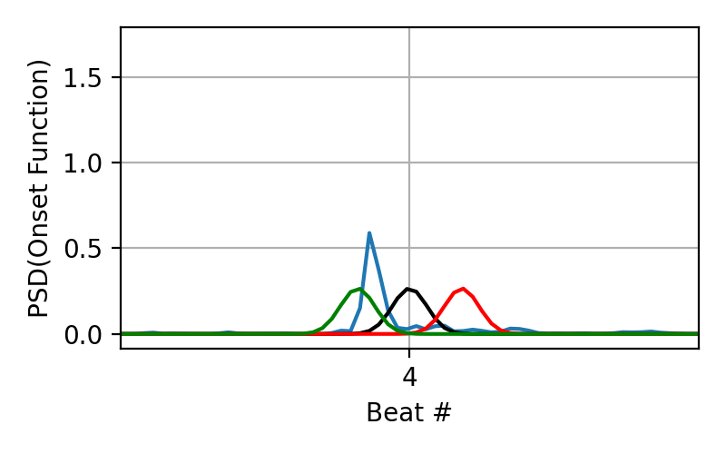

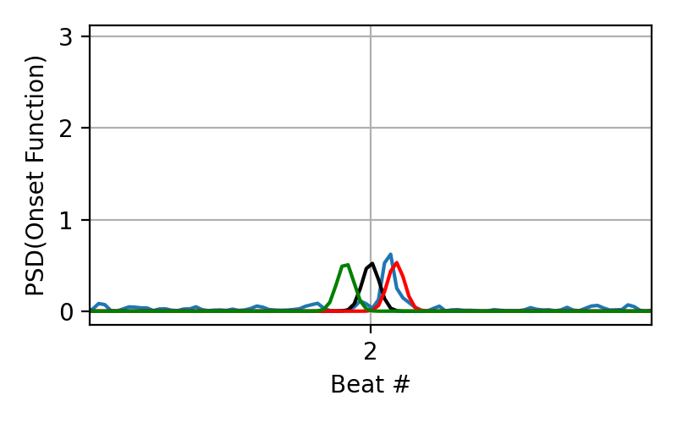
Extracted features
Early/Late at beat 4 for disco4
Early/Late at beat 2 for blues12

Slide 21
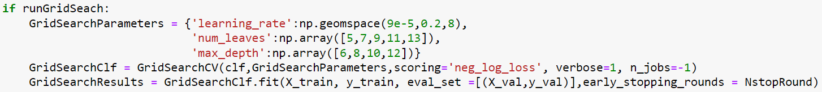
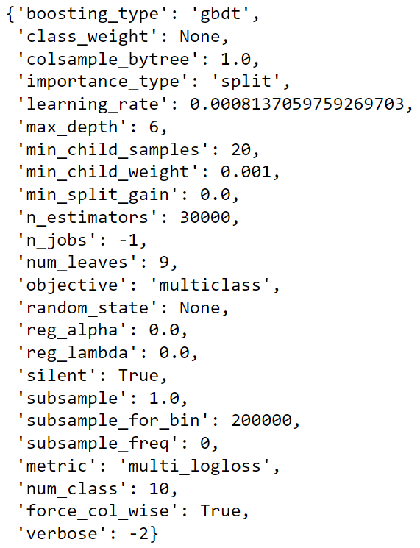
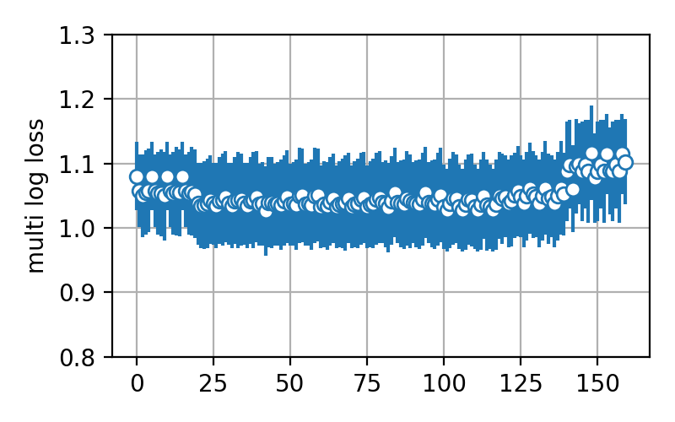
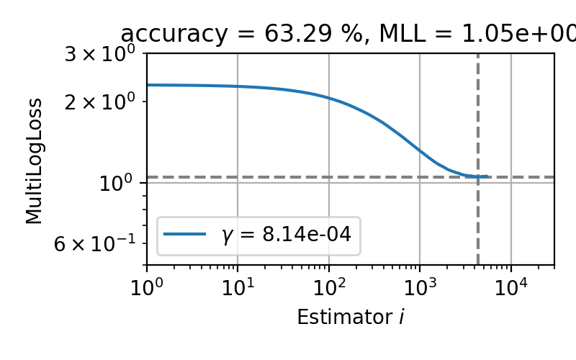
LGBM model details
Loss in grid search Validation loss best hyper params

Slide 22
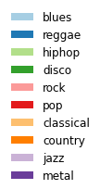
Top12 Pairplot
Fourier_mean
Overlap0
Roughness
Spectralrolloff
Chroma_cens
Chromagrammean
Fourier_std
Overlap5
Hardness
boominess
Overlap6
onBeatharmonic

Slide 23
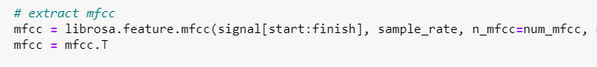

Preprocessing - NN
-Started with 100 samples per genre, then divided each by 5 to have more data
-Extracted MFCC’s using the Librosa package
-Parameters: n_fft=2048 (window for fft in num. of samples), hop_length=512 (in num. Of samples)
-Saved all MFCC’s, labels, and mapping to a .json file

Slide 24
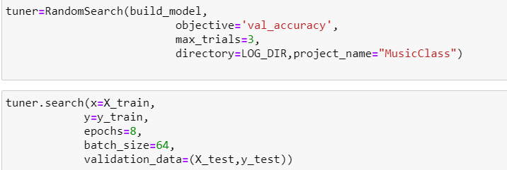
Tuning Neural Network
-Varied number of filters from 32 to 256 in steps of 32 for 2 Convolutional layers
- Tried with 1-3 Convoultional layers, also with 2-3 Dense layers

Slide 25
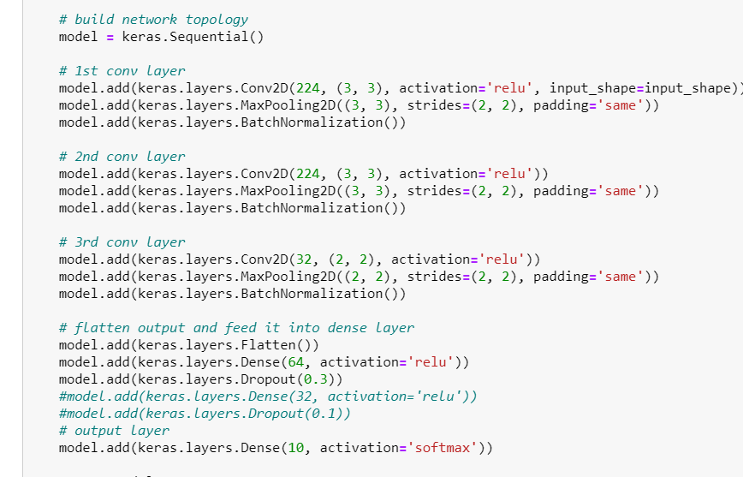
Neural network details
Activation= ReLu
Max Pool window = 2 x (3,3), then (2,2)
Strides = (2,2)
Padding=same
Optimizer= Adam
Learning rate=0.0001
Loss = sparse_categorical_crossentropy
Metrics=accuracy

Slide 26
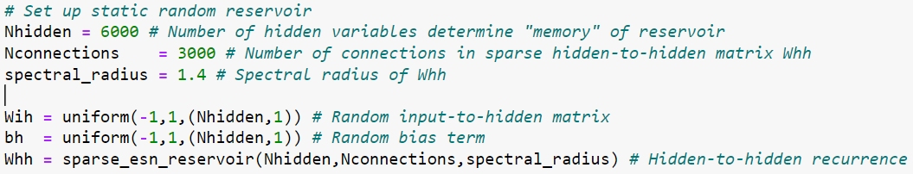
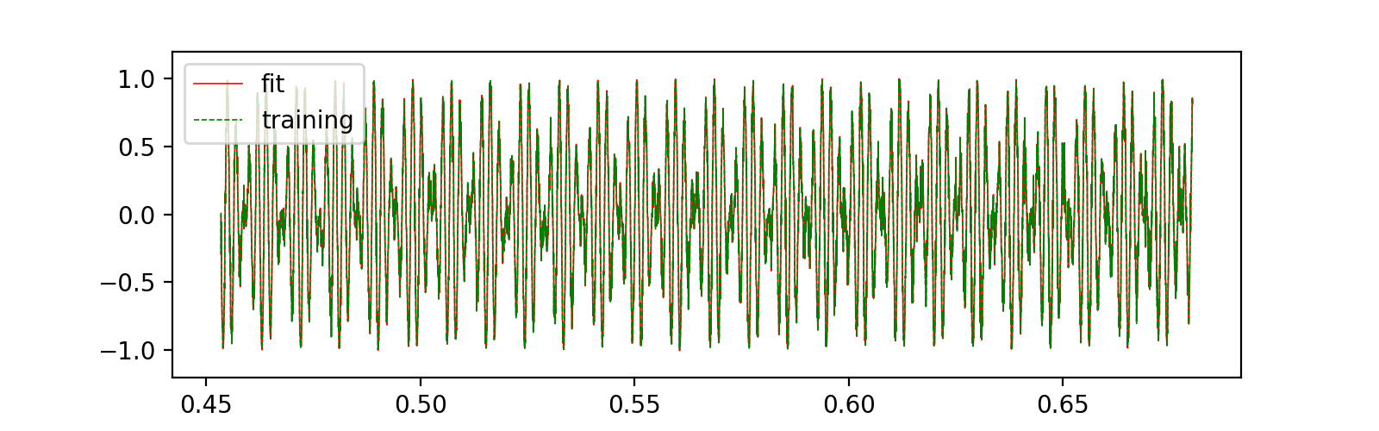
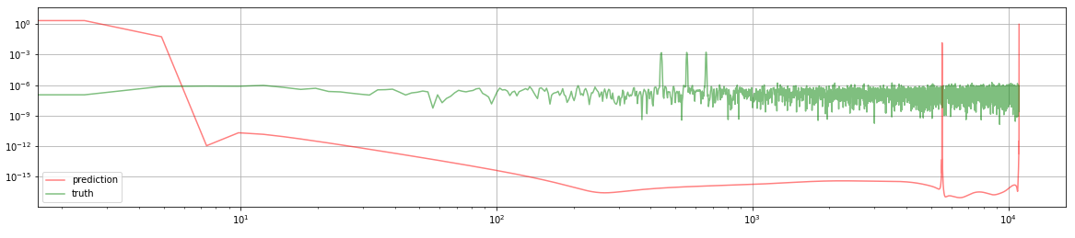
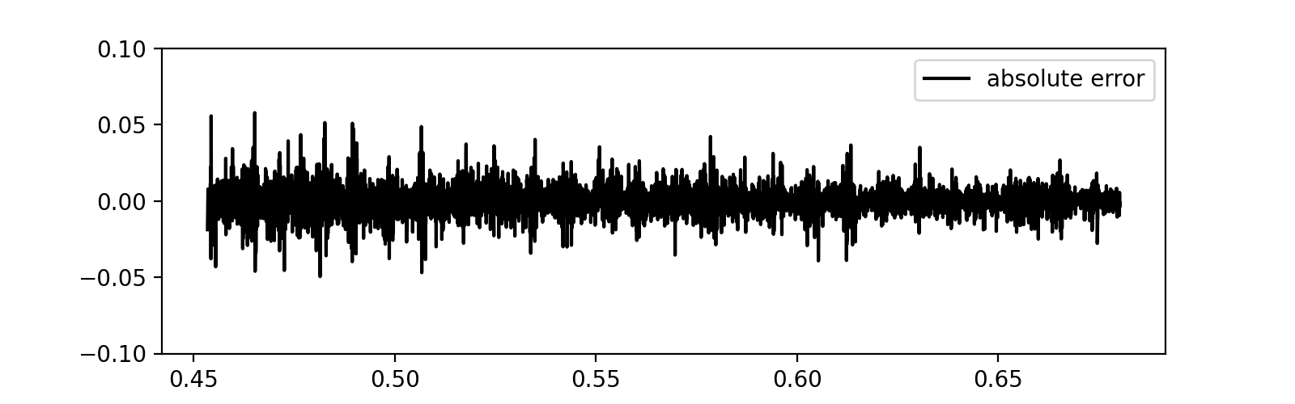
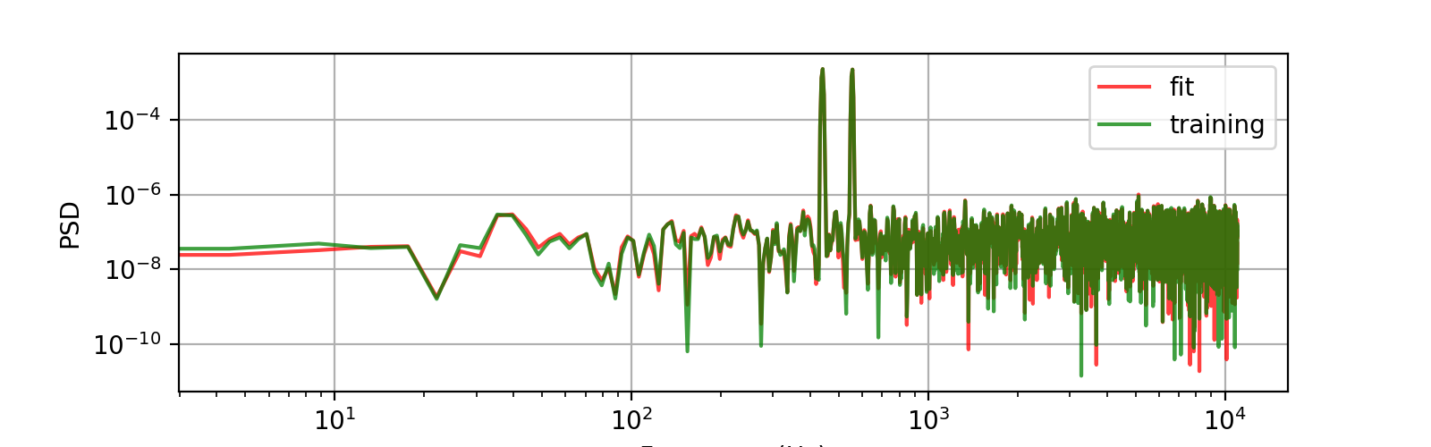
(how not to) Predict audio waveforms with ESN
tried directly on waveforms, no luck
Train on simple, slightly noisy sine waves
Main issue: very high sample rate for audio
Predicts OK for this simple data but breaks down for 3rd tone in a major chord.
Perhaps try instead to train on onset envelope?

